Slide 1
Slotting Research
Alokparna Bandyopadhyay
Kyle Moxley

Slide 2
2018 Data

Slide 3
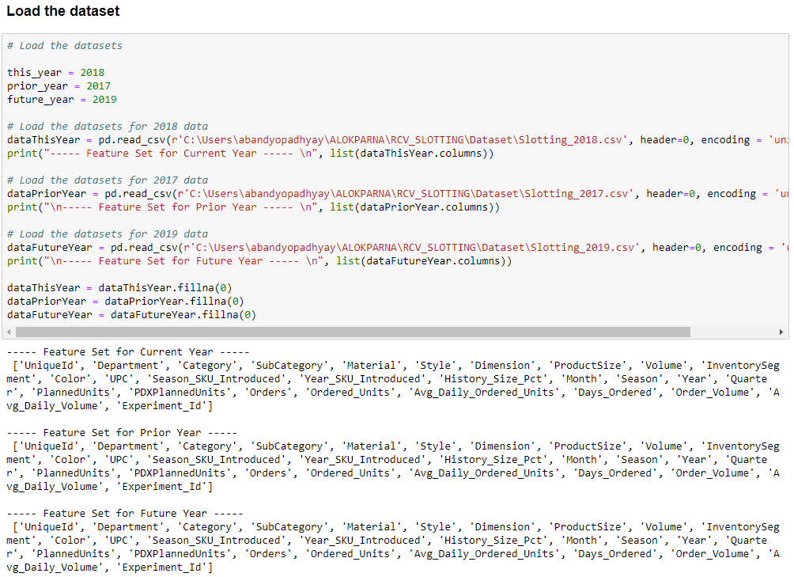
Datasets
We considered the Order data for –
2017 (prior)
2018 (current) and
2019 (future)

Slide 4
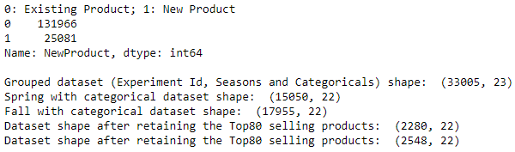
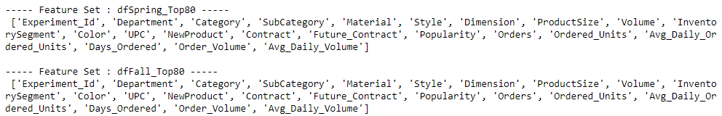
ETL and Selection of Top80 Sales
Impute the datasets with ‘0’
New features added for ‘Current contracts’ (2018) and ‘Future contracts’ (2019)
If ‘PlannedUnits’ is 0, then ‘PDXPlannedUnits’ is taken as Contracts, else ‘PlannedUnits’ is taken as Contracts
Remove those rows for which Orders are absent (0)
New feature added for ‘New Products’
Existing products: 0
New Products launched in 2018: 1
New feature added for ‘Popularity’ (never used)
A measure of how much was contracted and how much was actually sold
Change unit of volume from cu. inches to cu. feet
Group yearly dataset by Experiment_Id, Seasons and Categoricals
If Season = 0 → Group as Spring dataset If Season = 1 → Group as Fall dataset
Select the ‘Top80’ most sold items (UPCs) for Spring and Fall
dfSpring_Top80 & dfFall_Top80 → Used for CLUSTERING

Slide 5
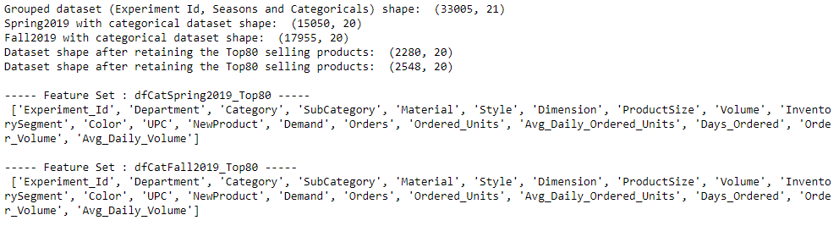
Feature Set Selection
Date: 09-05-2019
Considering Spring2018 data and Fall2018 data separately
Feature Set:
We combine various features for clustering and find out their co-relation matrix, p-values of co-relation matrix and confidence interval
AIM: Find out the best clustering feature set

Slide 6
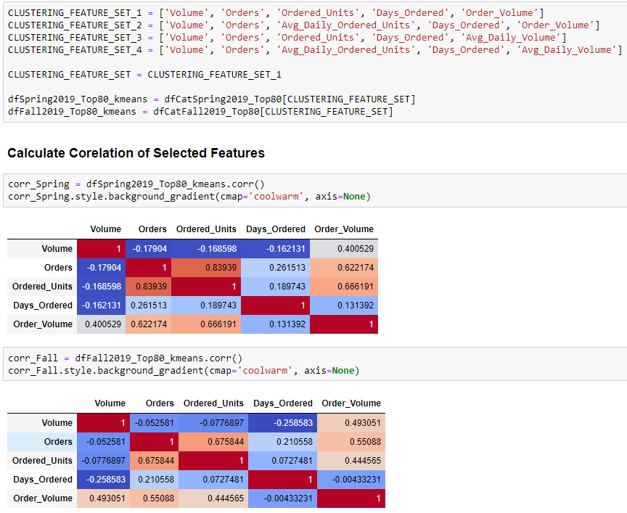
FEATURE_SET_1

Slide 7
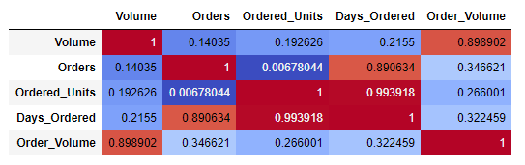
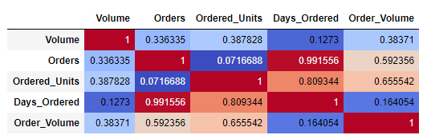
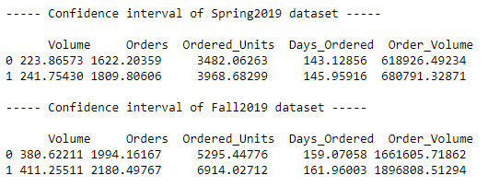
P-Value and Confidence Interval
Spring 2018
Fall 2018

Slide 8
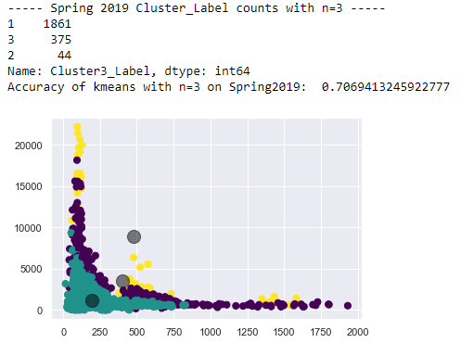
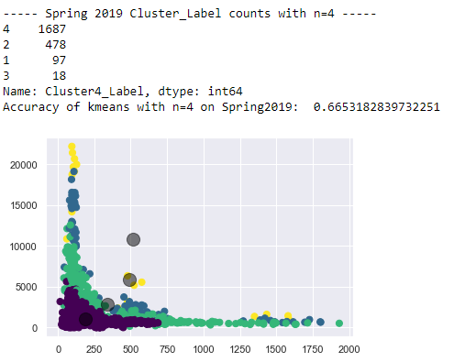
Spring2018 – KMeans
n=3
n=4

Slide 9
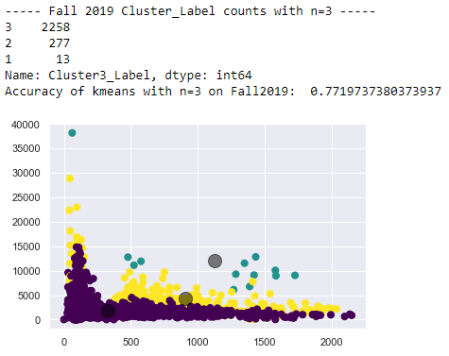
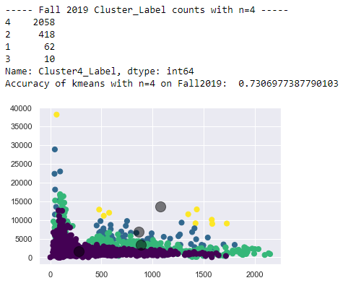
Fall2018 – KMeans
n=3
n=4

Slide 10
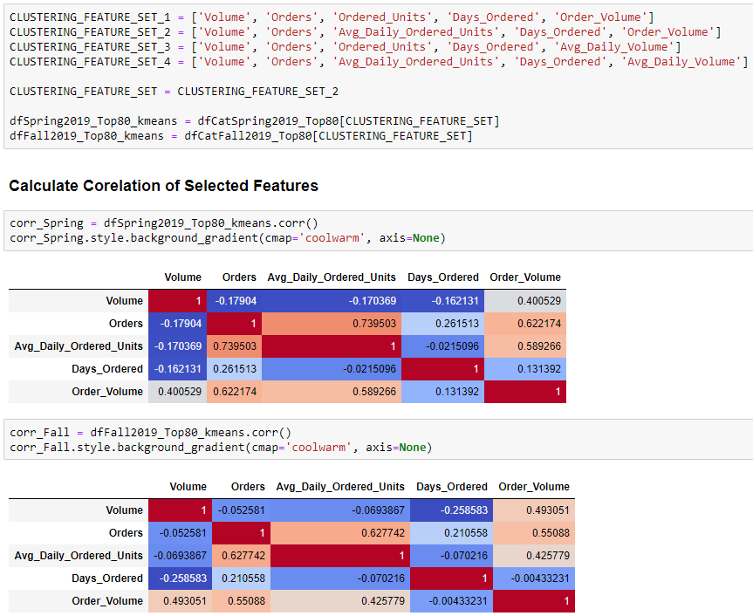
FEATURE_SET_2

Slide 11
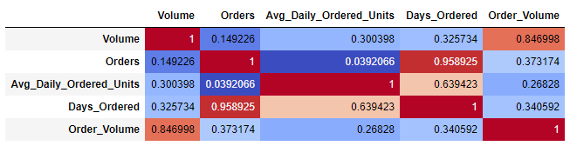
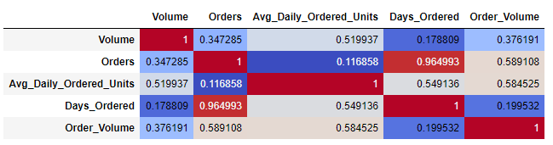
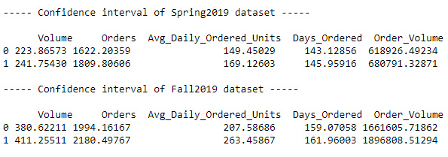
P-Value and Confidence Interval
Spring 2018
Fall 2018

Slide 12
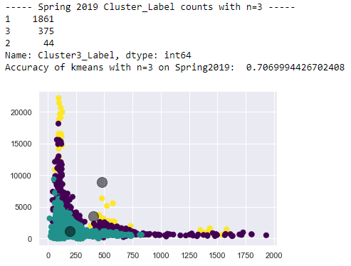
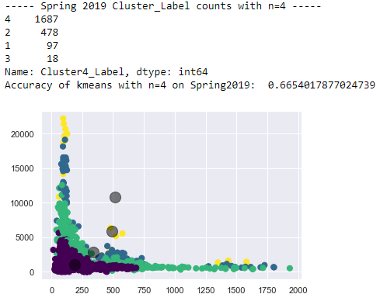
Spring2018 – KMeans
n=3
n=4

Slide 13
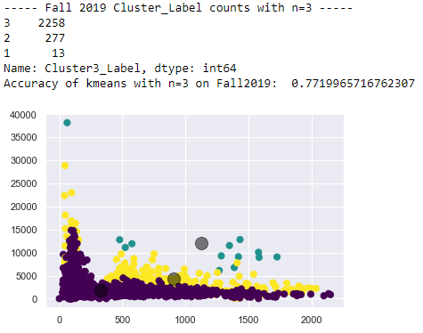

Fall2018 – KMeans
n=3
n=4

Slide 14
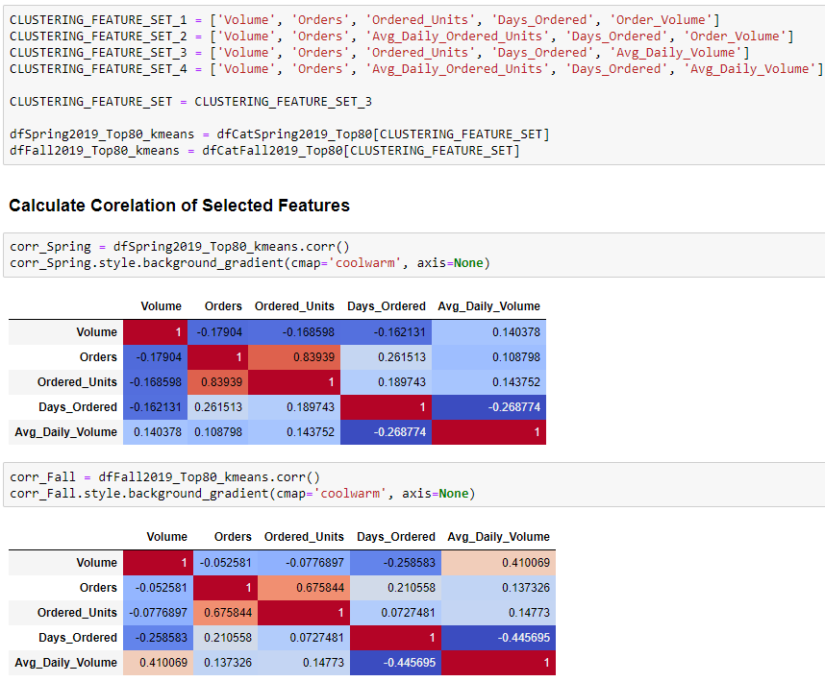
FEATURE_SET_3

Slide 15
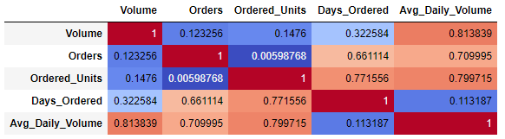
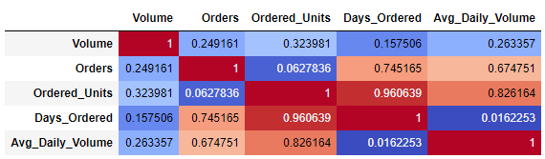
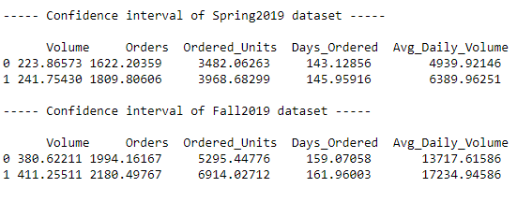
P-Value and Confidence Interval
Spring 2018
Fall 2018

Slide 16
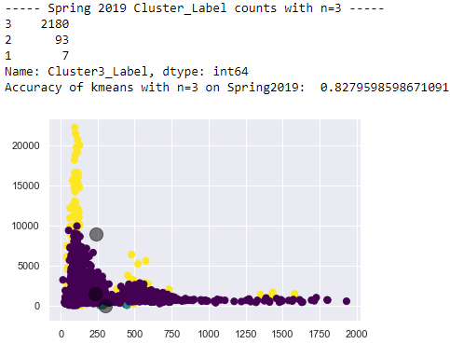
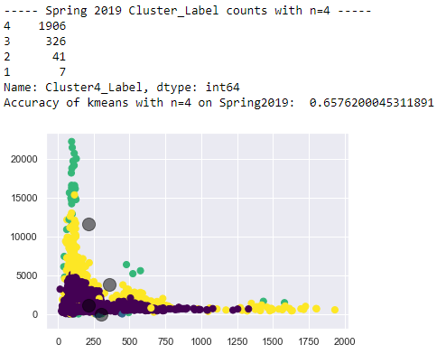
Spring2018 – KMeans
n=3
n=4

Slide 17
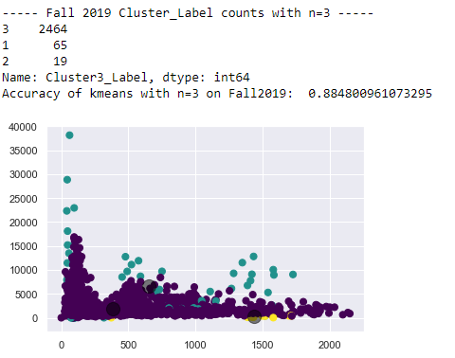
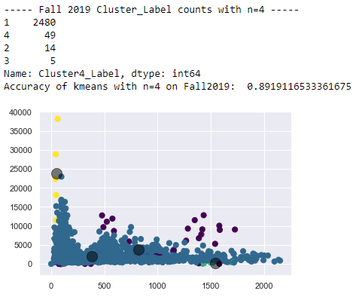
Fall2018 – KMeans
n=3
n=4

Slide 18
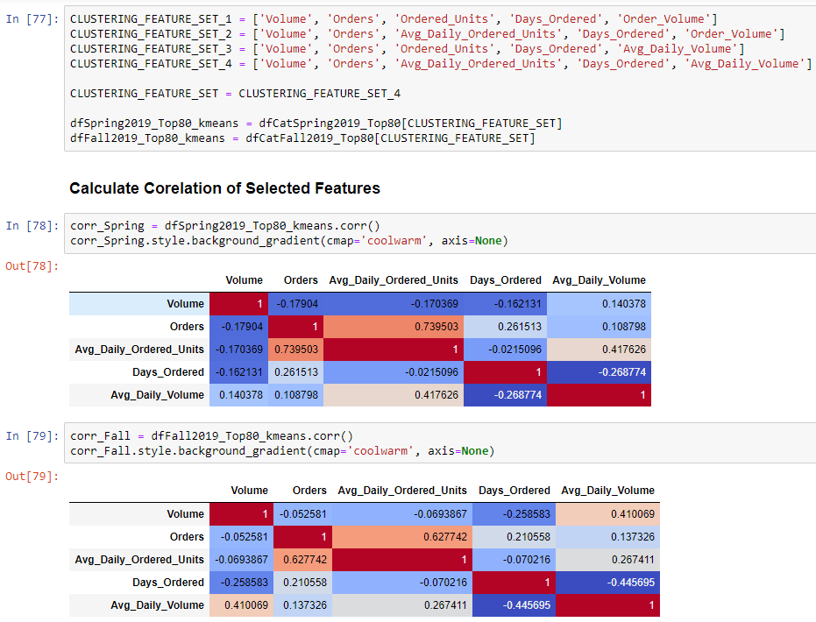
FEATURE_SET_4

Slide 19
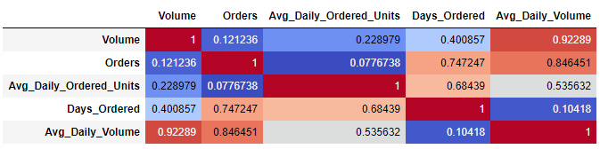
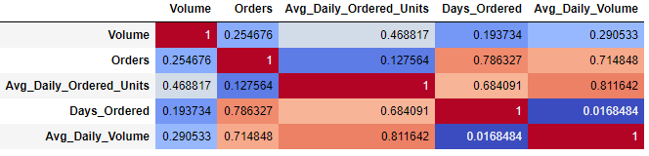
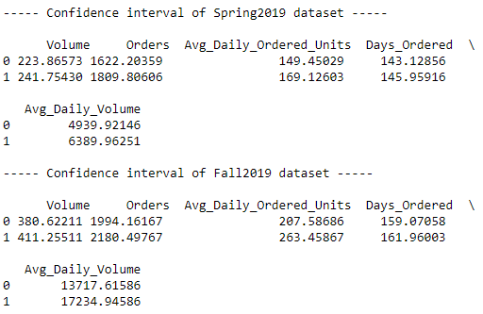
P-Value and Confidence Interval
Spring 2018
Fall 2018

Slide 20
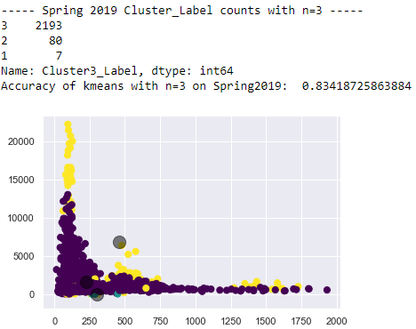
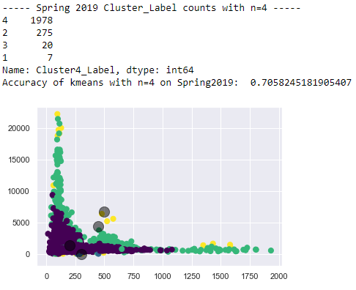
Spring2018 – KMeans
n=3
n=4
Main concern :
The spread of data points is highly inconsistent & cluster labels are highly imbalanced!

Slide 21
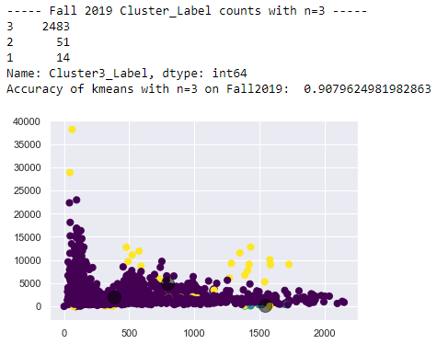
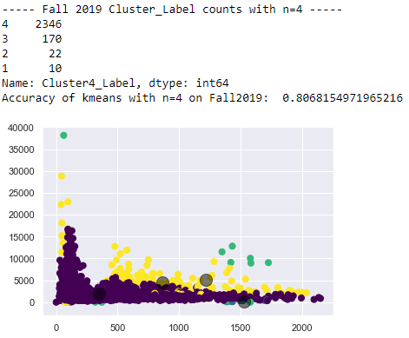
Fall2018 – KMeans
n=3
n=4
Main concern :
The spread of data points is highly inconsistent & cluster labels are highly imbalanced!

Slide 22
Decisions taken …
After looking at the results, we decided to select CLUSTERING_FEATURE_SET_4
Our main concern is that the spread of data points is highly inconsistent and the cluster labels are highly imbalanced!
We tried K-Means with both n=3 and n=4
Since n=4 does not give better result than n=3, we chose n=3 over n=4
We tried Bootstrap Resampling the Spring and Fall datasets
Results did not show anything better, so we used Original Datasets for clustering
Next we try Agglomerative Clustering and GMM Clustering to see if results are any better
We tried all 3 clustering techniques with scaled data and normalized data
Results did not show anything better, so we used Original Unscaled Datasets for clustering

Slide 23
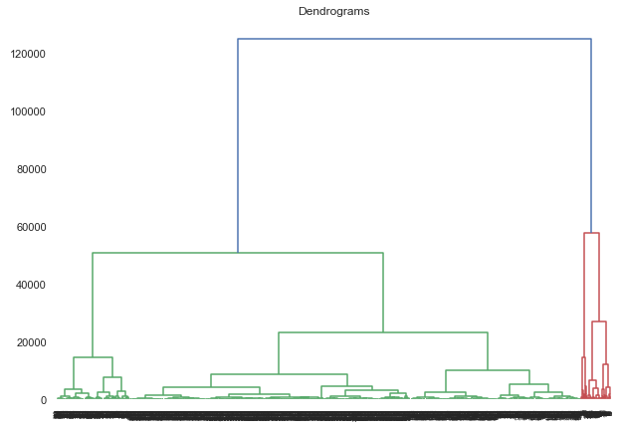
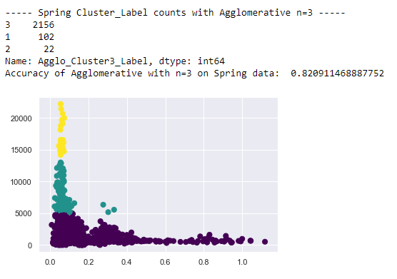
Spring2018 – Agglomerative Clustering
Main concern persists :
The spread of data points is highly inconsistent & cluster labels are highly imbalanced!

Slide 24
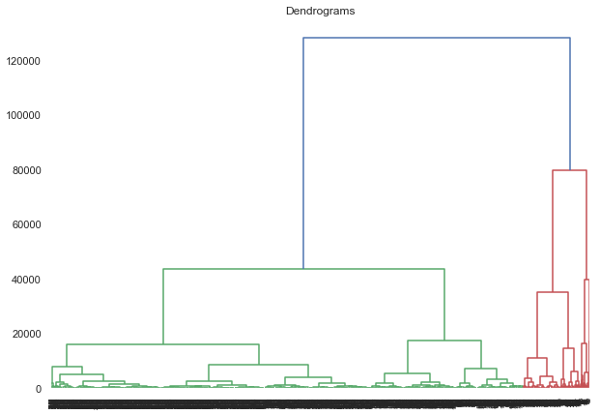
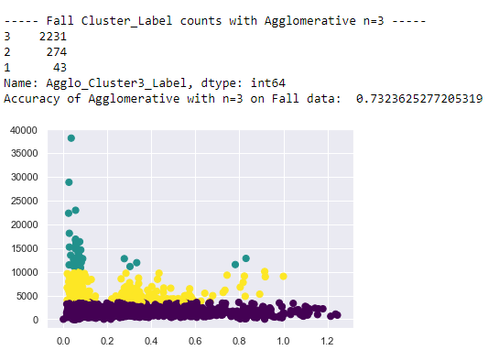
Fall2018 – Agglomerative Clustering
Main concern persists :
The spread of data points is highly inconsistent & cluster labels are highly imbalanced!
Next Step :
Try GMM Clustering Method

Slide 25
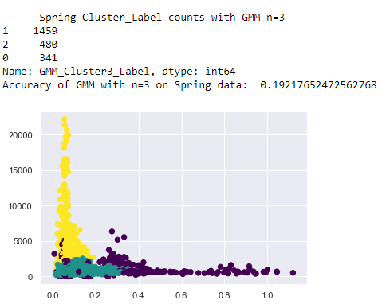
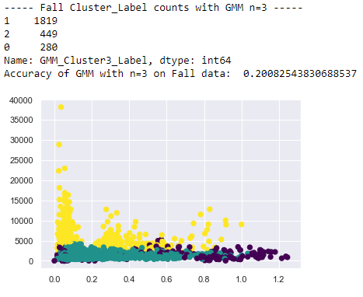
GMM Clustering
Spring 2018
Fall 2018
Good point: The spread of data points is comparatively consistent
Note: Silhouette Score went down, but that is mainly because GMM clustering technique uses Soft Clustering Method
Next Step : Resampling of the data to balance the classes –
We take a mean of the total number of cluster labels and upsample/downsample the cluster labels to that mean

Slide 26
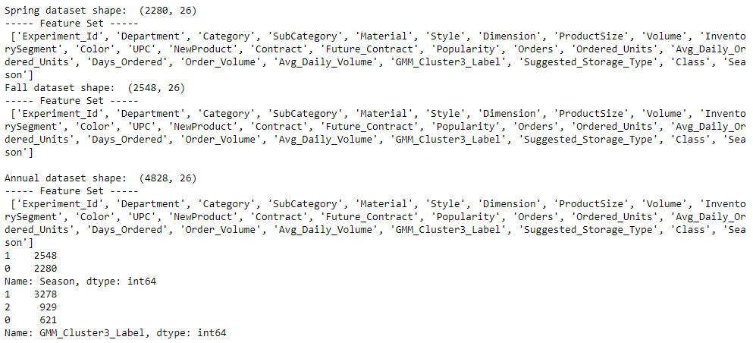
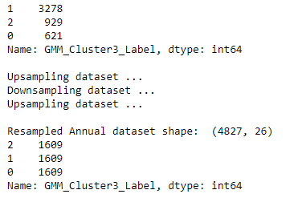
Decisions taken …
Pass the GMM Cluster Labels as Target through an MNLogit model
Find the Fit-Statistics for Spring2018 and Fall2018 datasets
Merge the Spring and Fall Datasets to form an Annual2018 Dataset with a new Feature for Seasons – Spring: 0 and Fall: 1 and find its Fit-Statistics
Find the Fit Statistics for –
Original Data
Resampled Data
Resample the data to balance the classes – We take a mean of the total number of cluster labels and upsample/downsample the cluster labels to that mean
# For Annual Classification
FEATURE_SET = ['Ordered_Units', 'Future_Contract', 'NewProduct', 'Season']
TARGET_CLUSTER = ['GMM_Cluster3_Label']
TARGET_CLASS = ['Class']

Slide 27
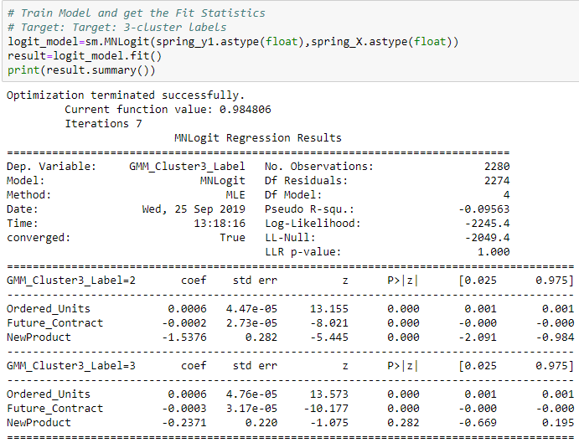
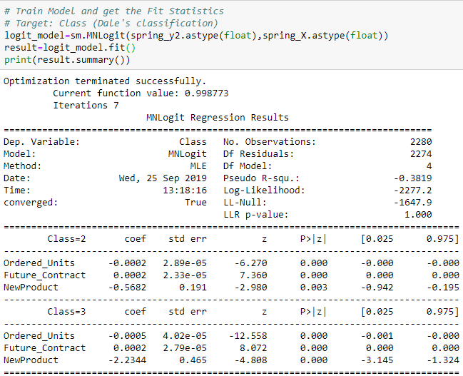
Spring 2018 without resampling
GMM Cluster Labels
Dale’s Classification

Slide 28
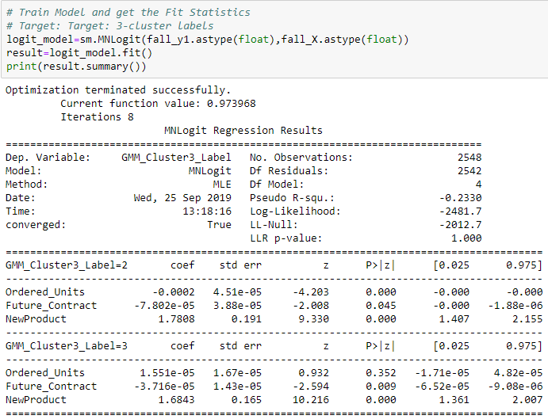
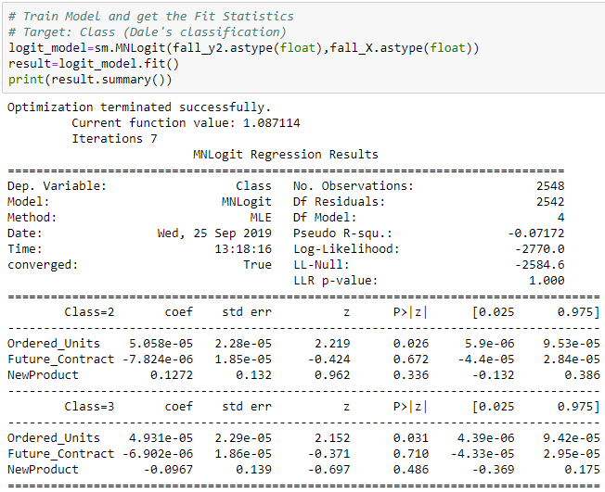
Fall 2018 without resampling
GMM Cluster Labels
Dale’s Classification

Slide 29
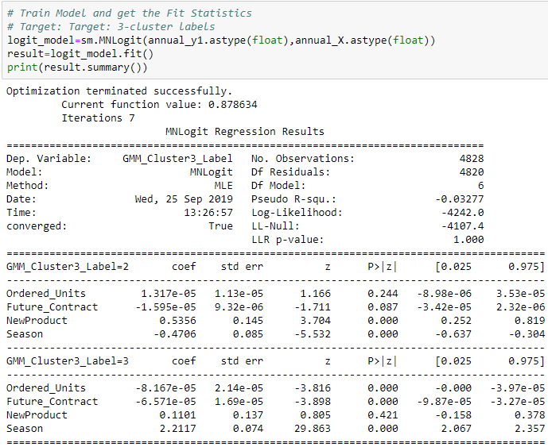
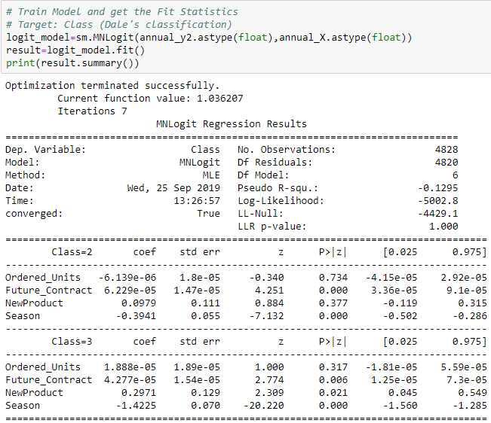
Annual 2018 without resampling
GMM Cluster Labels
Dale’s Classification

Slide 30
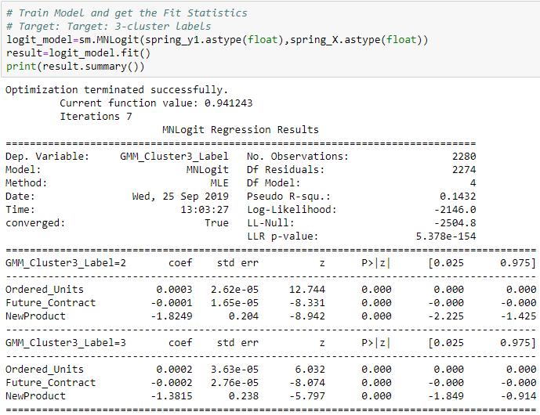

Spring 2018 after resampling
GMM Cluster Labels
Dale’s Classification

Slide 31


Fall 2018 after resampling
GMM Cluster Labels
Dale’s Classification

Slide 32


Annual 2018 after resampling
GMM Cluster Labels
Dale’s Classification

Slide 33


Annual 2018 – MNLogit (OvR)
GMM Cluster Labels
Dale’s Classification

Slide 34


Annual 2018 – MNLogit (Multinomial)
GMM Cluster Labels
Dale’s Classification

Slide 35


Predict Class Labels of Annual Dataset

Slide 36
Summary: Current Process
Order Process
Need to test whether the suggested storage types adequately accounts for the entire A+ picking area
Use Clustering Techniques on Seasonal Data to group similar materials based on Volume and specific Order Details for Spring/Fall
Order data for 2018
Considering Top 80% most sold products
Features used for Clustering:
Material Volume
Orders
Average Daily Ordered units
Days Ordered
Average Daily Order Volume
Cluster Labels are noted
K-means Clustering
Agglomerative Clustering
→ GMM Clustering
Unforeseen Features used to train the Classification Model on Annual Data:
Ordered Units
New Product
Future Contract (2019)
Season
GMM Cluster Labels used as Target
Classification Model
Multinomial Logistic Regression
*GMM : Gaussian Mixture Models

Slide 37

Class Breakdown by Features
Classes remain consistent in Spring and Fall
Items with highest velocity fall under Class-2, followed by Class-0 and Class-1

Slide 38


Cluster-Class Breakdown by Season
SPRING
FALL
Comparative analysis of Clusters adjusted to the Predicted Class
Cluster Labels are how they grouped together based on Material Volume & Order specific details
Predicted Class is how they will group together once we take Future Contracts and New Product information into account
SPRING
FALL

Slide 39
Appendix
Slotting Annual Prediction Report
Slotting Classification Pipeline
SQL Query from Data Engineering Team
Mock Data from Dale

Slide 40
2019 Data

Slide 41

Feature Set Selection for KMeans
Date: 08-26-2019
Considering Spring2019 data and Fall2019 data separately
Feature Set:
We combine various features and try to cluster
AIM: Find out the best clustering feature set

Slide 42

FEATURE_SET_1

Slide 43


P-Value and Confidence Interval

Slide 44


Spring2019 – KMeans
n=3
n=4

Slide 45


Fall2019 – KMeans
n=3
n=4

Slide 46

FEATURE_SET_2

Slide 47


P-Value and Confidence Interval

Slide 48


Spring2019 – KMeans
n=3
n=4

Slide 49


Fall2019 – KMeans
n=3
n=4

Slide 50

FEATURE_SET_3

Slide 51


P-Value and Confidence Interval

Slide 52

Spring2019 – KMeans
n=3
n=4

Slide 53


Fall2019 – KMeans
n=3
n=4

Slide 54

FEATURE_SET_4

Slide 55


P-Value and Confidence Interval

Slide 56


Spring2019 – KMeans
n=3
n=4

Slide 57


Fall2019 – KMeans
n=3
n=4

Slide 58








Box-plots: Target vs Avg_Daily_Volume

Slide 59

Classification Dataset

Slide 60



Feature Set Selection for Classification
NewProduct has no correlation with the other features and so its not showing up in the correlation matrix
Accuracy Score of Multinomial Logit

Slide 61



Feature Set Selection for Classification
NewProduct has no correlation with the other features and so its not showing up in the correlation matrix
Accuracy Score of Multinomial Logit

Slide 62
Feature Set Selection for Classification
NewProduct has no correlation with the other features and so its not showing up in the correlation matrix
Accuracy Score of Multinomial Logit

